Slide 1
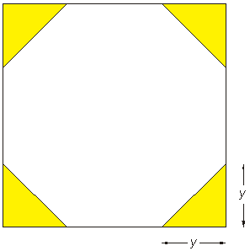
Plenary - Octagon
I have a square piece of card. I cut a triangle from each corner so that the remaining card is in the shape of a regular octagon.
The perimeter of the regular octagon is 32cm.
Work out length y

Slide 2
Plenary - Octagon
Each side of the octagon is

